Slide 1

Portfolio allocation with GHG emissions constraints - Energy Firms
Group 8: Charlotte 🇩🇪, David 🇨🇭🇬🇧, Guillaume 🇨🇭🇵🇹 & Per Christian 🇳🇴
Sustainable and Entrepreneurial Finance (Prof. Jondeau) - Assignment 2

Slide 2
Q1: We focus on energy firms. Their stocks are volatile & carbon-intensive, esp. Scopes 1 & 3 (TRUCOST)
 | Scope 1 | Scope 2 | Scope 3 | Scope Total
# Observations | 27288 | 27288 | 27288 | 27288
Min | 1,04 | 0,00 | 22,47 | 41,74
Max | 43437,14 | 2772,09 | 1591,51 | 43839,07
Mean | 618,73 | 65,56 | 260,64 | 944,93
Median | 280,86 | 36,13 | 239,08 | 622,67
Standard Deviation | 1885,77 | 132,49 | 174,16 | 1920,79

Slide 3
Q1: Scope 1 emissions dominate, reflecting the carbon intense nature of fossil fuel production
 | Scope 1 | Scope 2 | Scope 3 | Scope Total
# Observations | 27288 | 27288 | 27288 | 27288
Min | 1,04 | 0,00 | 22,47 | 41,74
Max | 43437,14 | 2772,09 | 1591,51 | 43839,07
Mean | 618,73 | 65,56 | 260,64 | 944,93
Median | 280,86 | 36,13 | 239,08 | 622,67
Standard Deviation | 1885,77 | 132,49 | 174,16 | 1920,79

Slide 4
Q1: The large gap between the Mean and Median of Scope 1 and Total highlights huge outliers
 | Scope 1 | Scope 2 | Scope 3 | Scope Total
# Observations | 27288 | 27288 | 27288 | 27288
Min | 1,04 | 0,00 | 22,47 | 41,74
Max | 43437,14 | 2772,09 | 1591,51 | 43839,07
Mean | 618,73 | 65,56 | 260,64 | 944,93
Median | 280,86 | 36,13 | 239,08 | 622,67
Standard Deviation | 1885,77 | 132,49 | 174,16 | 1920,79

Slide 5
Q1: The Standard Deviation supports the same findings
 | Scope 1 | Scope 2 | Scope 3 | Scope Total
# Observations | 27288 | 27288 | 27288 | 27288
Min | 1,04 | 0,00 | 22,47 | 41,74
Max | 43437,14 | 2772,09 | 1591,51 | 43839,07
Mean | 618,73 | 65,56 | 260,64 | 944,93
Median | 280,86 | 36,13 | 239,08 | 622,67
Standard Deviation | 1885,77 | 132,49 | 174,16 | 1920,79

Slide 6
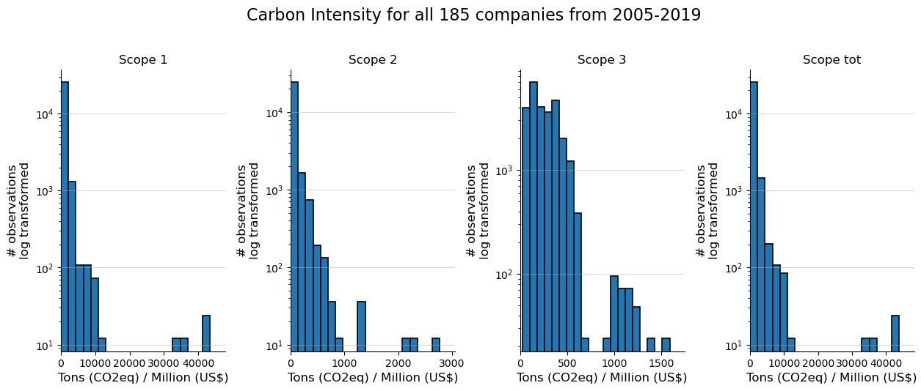
Q1: The observations have a highly skewed distribution with some outliers

Slide 7
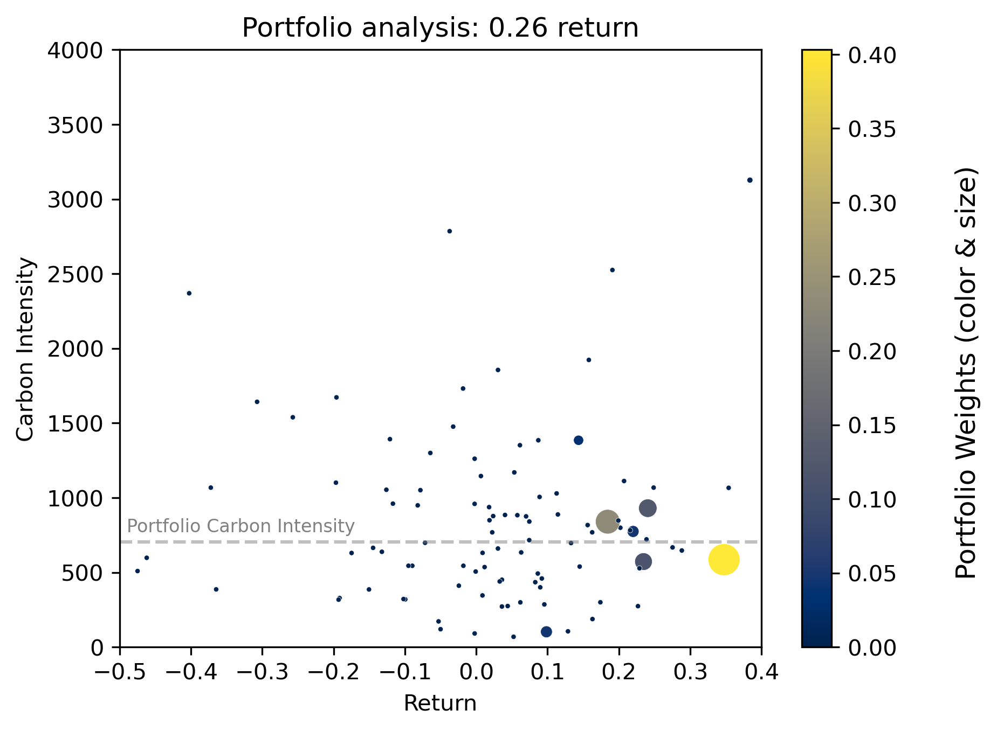
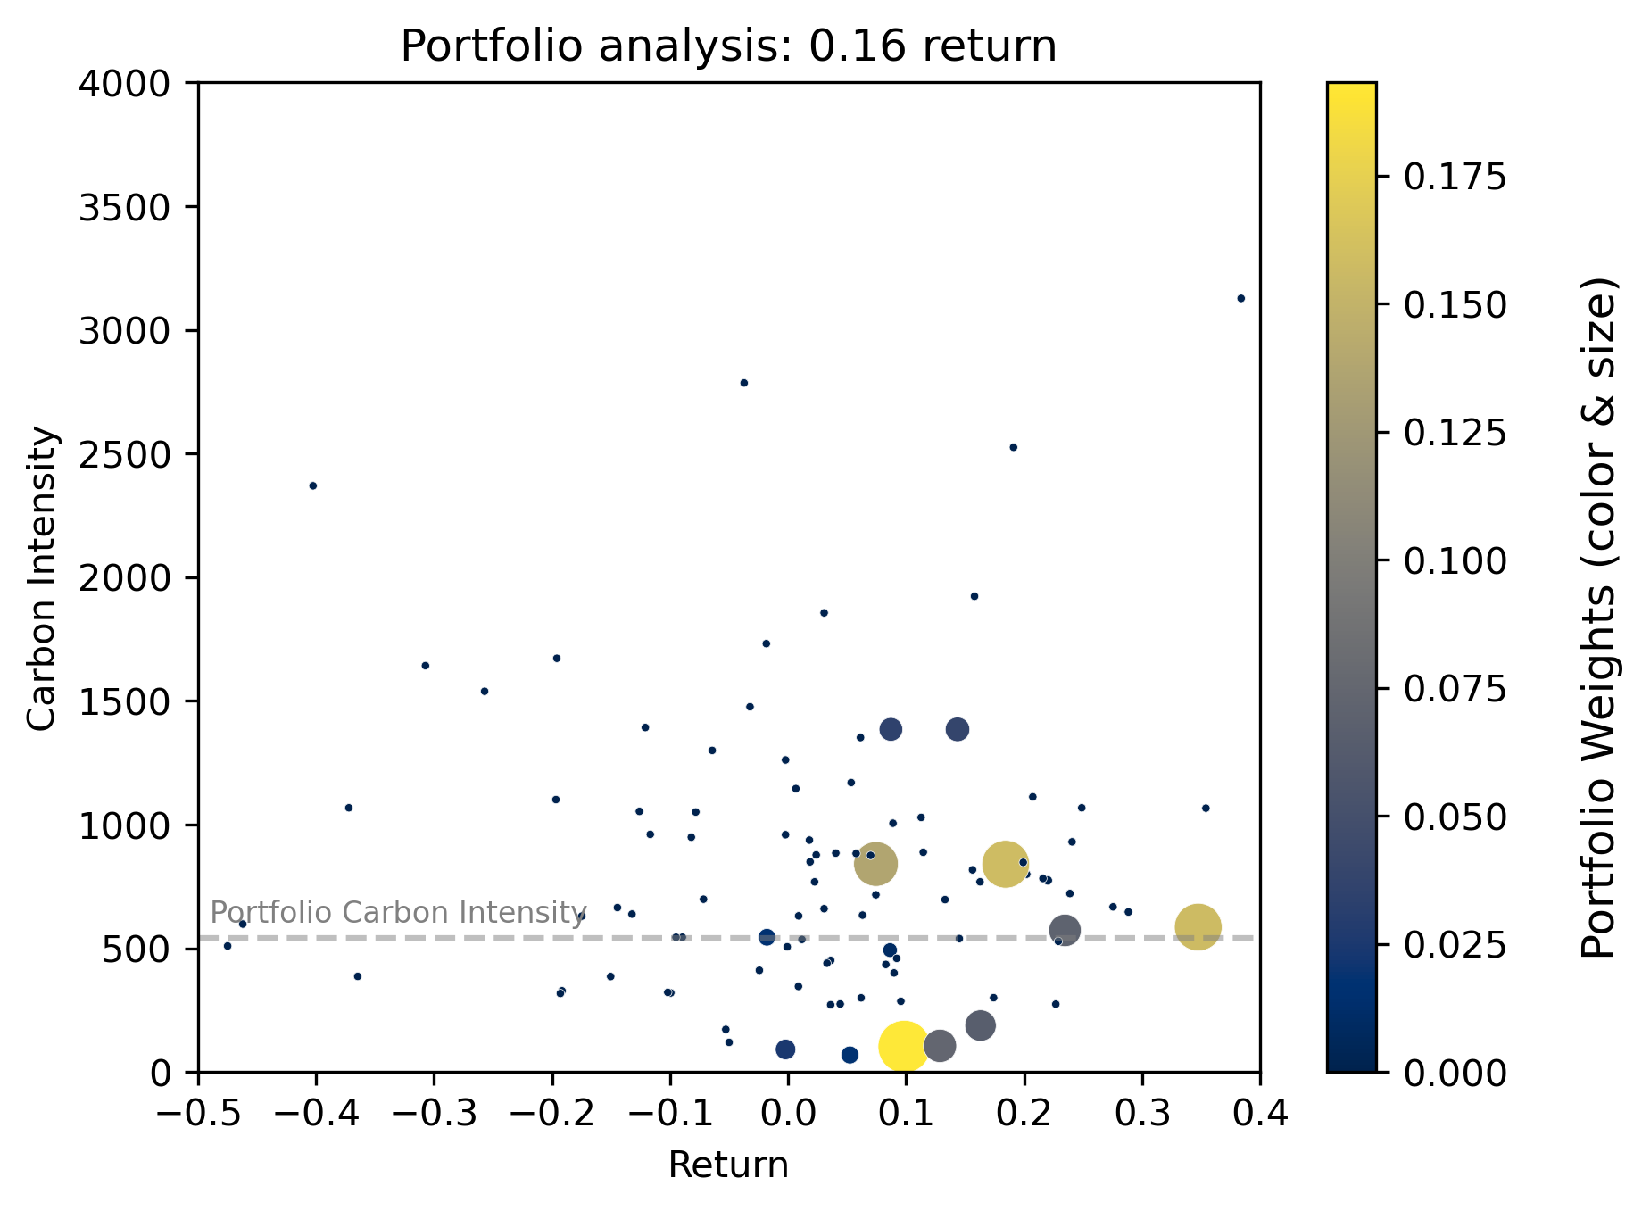
Q2: Different portfolios returns lead to very different asset allocations

Slide 8
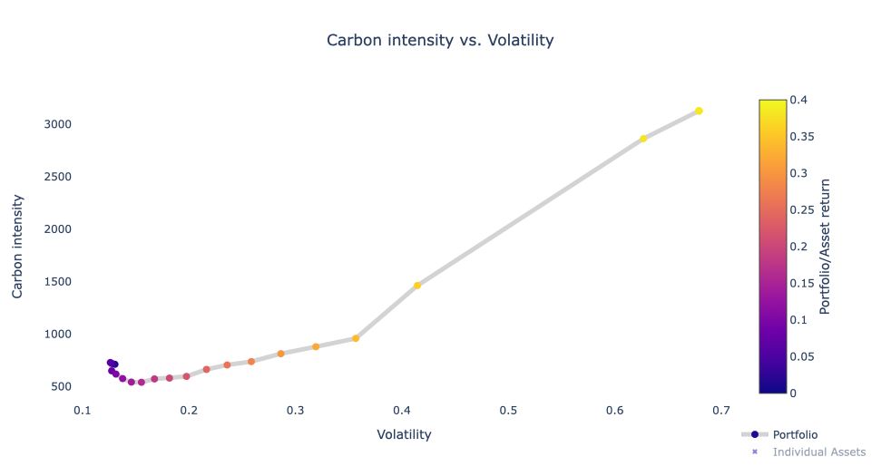
Q2: Portfolio volatilities are positively correlated with carbon intensities

Slide 9
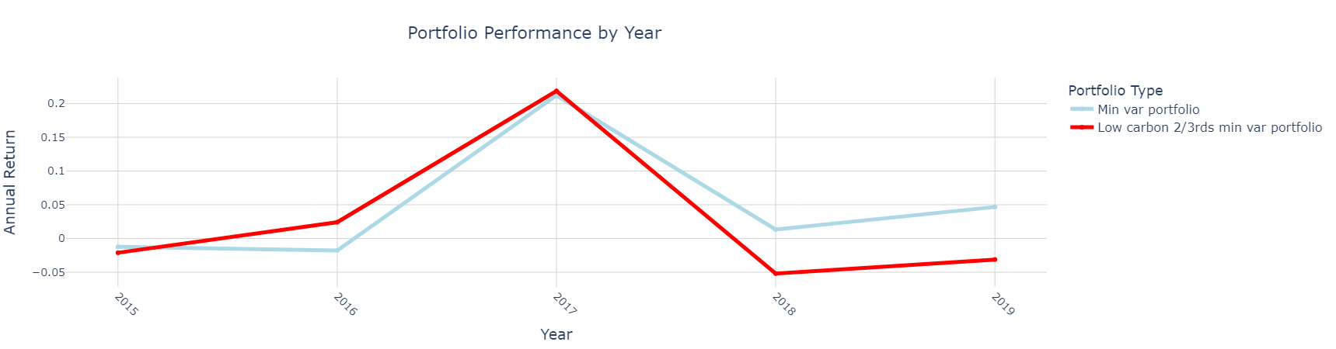
Q3: We created a min var portfolio with the 67% lowest carbon-intensive firms
The lower ⅔ carbon portfolio has lower returns than the “normal” min var portfolio (2.77% vs 4.84% AAR).

Slide 10
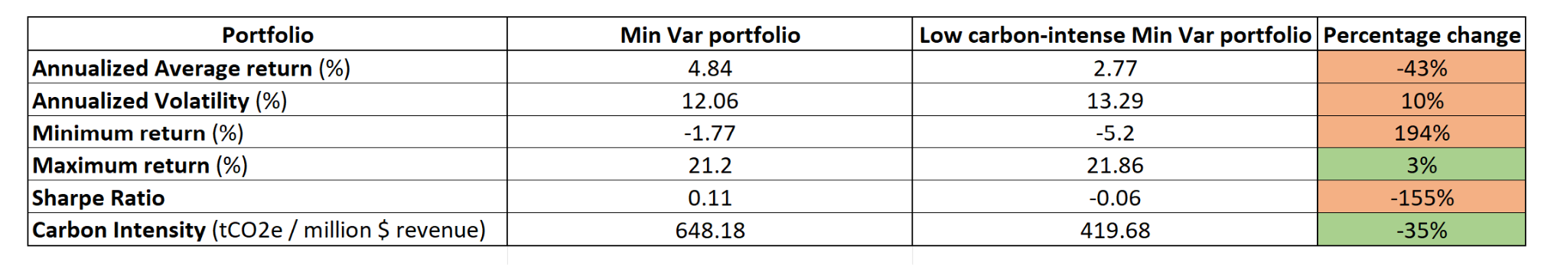
Q3: The min var portfolio outperforms the lower ⅔ carbon min var portfolio
Low ⅔ carbon min var portfolio
43% lower return
10% higher volatility
Negative sharpe ratio
35% decrease in Carbon Intensity

Slide 11
Q4: The Value-Weighted Portfolios yields better returns across all Quintiles except Quintile four
 | Equally Weighted Portfolio |  |  |  |  | Long - Short | Value Weighted Portfolio |  |  |  |  | Long - Short
Quintile | 1 | 2 | 3 | 4 | 5 | 1-5 | 1 | 2 | 3 | 4 | 5 | 1-5
Portfolio Intensity | 225 | 472 | 624 | 804 | 2043 | - | 225 | 472 | 624 | 804 | 2043 | -
Portfolio Market Cap (US Billions) | 18 | 21 | 39 | 51 | 25 | - | 18 | 21 | 39 | 51 | 25 | -
AAR | 8,7% | 8,9% | 7,8% | 7,5% | 5,7% | 0,2% | 9,3% | 12,3% | 10,7% | 7,2% | 7,6% | 2,8%
Annualized Mean Volatility | 0,43 | 0,44 | 0,39 | 0,36 | 0,41 | 0,11 | 0,27 | 0,26 | 0,22 | 0,21 | 0,27 | 0,14
Minimum Monthly Return | -31,8% | -23,8% | -21,4% | -23,2% | -30,2% | -9,4% | -25,0% | -19,1% | -15,9% | -15,1% | -28,7% | -15,1%
Maximum Monthly Return | 26,0% | 33,2% | 27,3% | 22,8% | 25,0% | 10,2% | 24,9% | 23,5% | 21,9% | 21,4% | 30,9% | 10,6%
Sharpe Ratio | 0,12 | 0,12 | 0,11 | 0,11 | 0,05 | -0,29 | 0,22 | 0,34 | 0,33 | 0,18 | 0,15 | -0,05

Slide 12
Q4: The “green” Quintiles perform better than the “brown” Quintiles for both portfolio types
 | Equally Weighted Portfolio |  |  |  |  | Long - Short | Value Weighted Portfolio |  |  |  |  | Long - Short
Quintile | 1 | 2 | 3 | 4 | 5 | 1-5 | 1 | 2 | 3 | 4 | 5 | 1-5
Portfolio Intensity | 225 | 472 | 624 | 804 | 2043 | - | 225 | 472 | 624 | 804 | 2043 | -
Portfolio Market Cap (US Billions) | 18 | 21 | 39 | 51 | 25 | - | 18 | 21 | 39 | 51 | 25 | -
AAR | 8,7% | 8,9% | 7,8% | 7,5% | 5,7% | 0,2% | 9,3% | 12,3% | 10,7% | 7,2% | 7,6% | 2,8%
Annualized Mean Volatility | 0,43 | 0,44 | 0,39 | 0,36 | 0,41 | 0,11 | 0,27 | 0,26 | 0,22 | 0,21 | 0,27 | 0,14
Minimum Monthly Return | -31,8% | -23,8% | -21,4% | -23,2% | -30,2% | -9,4% | -25,0% | -19,1% | -15,9% | -15,1% | -28,7% | -15,1%
Maximum Monthly Return | 26,0% | 33,2% | 27,3% | 22,8% | 25,0% | 10,2% | 24,9% | 23,5% | 21,9% | 21,4% | 30,9% | 10,6%
Sharpe Ratio | 0,12 | 0,12 | 0,11 | 0,11 | 0,05 | -0,29 | 0,22 | 0,34 | 0,33 | 0,18 | 0,15 | -0,05

Slide 13
Q4: Going long in Quintile 1 and short in Quintile 5 for the 105 companies shows no “Greenium”
 | Equally Weighted Portfolio |  |  |  |  | Long - Short | Value Weighted Portfolio |  |  |  |  | Long - Short
Quintile | 1 | 2 | 3 | 4 | 5 | 1-5 | 1 | 2 | 3 | 4 | 5 | 1-5
Portfolio Intensity | 225 | 472 | 624 | 804 | 2043 | - | 225 | 472 | 624 | 804 | 2043 | -
Portfolio Market Cap (US Billions) | 18 | 21 | 39 | 51 | 25 | - | 18 | 21 | 39 | 51 | 25 | -
AAR | 8,7% | 8,9% | 7,8% | 7,5% | 5,7% | 0,2% | 9,3% | 12,3% | 10,7% | 7,2% | 7,6% | 2,8%
Annualized Mean Volatility | 0,43 | 0,44 | 0,39 | 0,36 | 0,41 | 0,11 | 0,27 | 0,26 | 0,22 | 0,21 | 0,27 | 0,14
Minimum Monthly Return | -31,8% | -23,8% | -21,4% | -23,2% | -30,2% | -9,4% | -25,0% | -19,1% | -15,9% | -15,1% | -28,7% | -15,1%
Maximum Monthly Return | 26,0% | 33,2% | 27,3% | 22,8% | 25,0% | 10,2% | 24,9% | 23,5% | 21,9% | 21,4% | 30,9% | 10,6%
Sharpe Ratio | 0,12 | 0,12 | 0,11 | 0,11 | 0,05 | -0,29 | 0,22 | 0,34 | 0,33 | 0,18 | 0,15 | -0,05

Slide 14
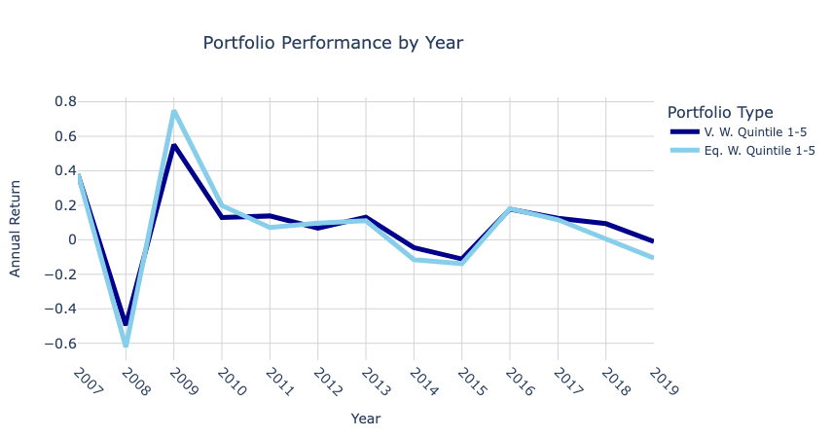
Q4: The Equally-Weighted Portfolio exhibits higher volatility than the Value Weighted Portfolio

Slide 15
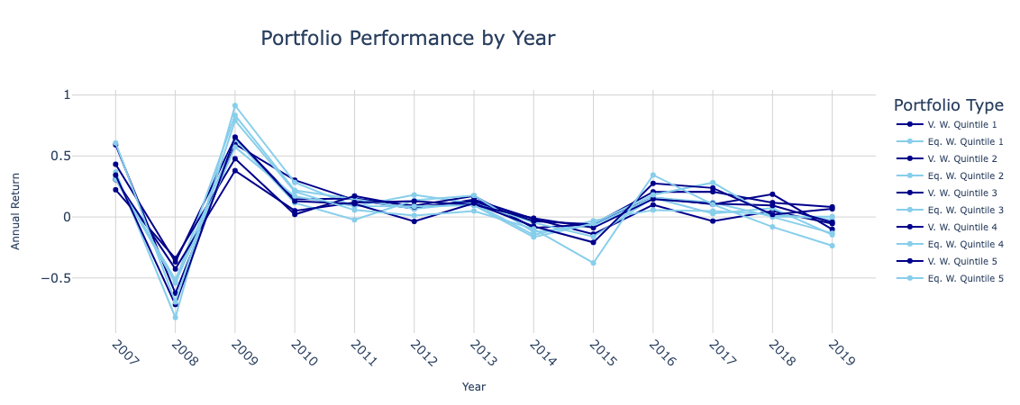
Q4: Plotting each V.W and Eq. V quintile portfolio gives a more nuanced picture of the returns

Slide 16
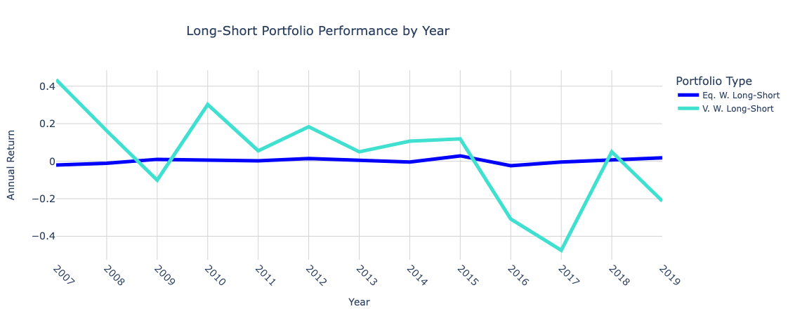
Q4: Investing in the Value-Weighted Long-Short portfolio gives an AAR of 2,8% but is highly volatile

Slide 17
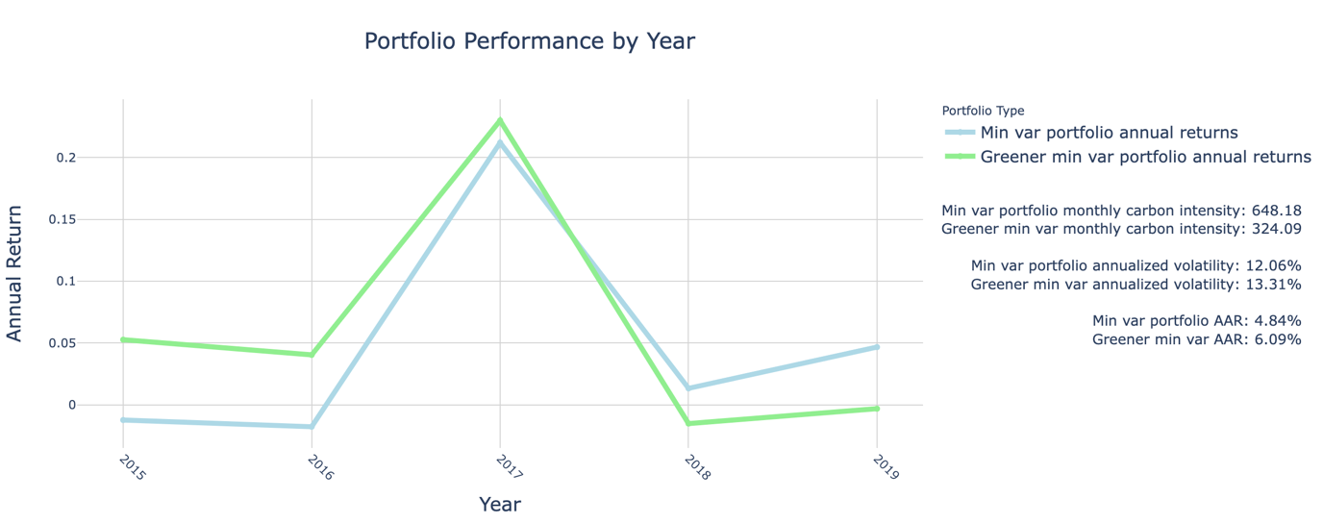
Q5: Reducing the carbon intensity of the min var portfolio by 50% led to more attractive results
Our ‘Greener min var (MV)’ portfolio has a better risk-adjusted return than the original MV portfolio (Sharpe ratio 0.195 vs 0.111). +We get better results than the Q3 portfolio!
Notes:
Important to note (orally) that this constraint is more attractive than the portfolio from Q3!

Slide 18
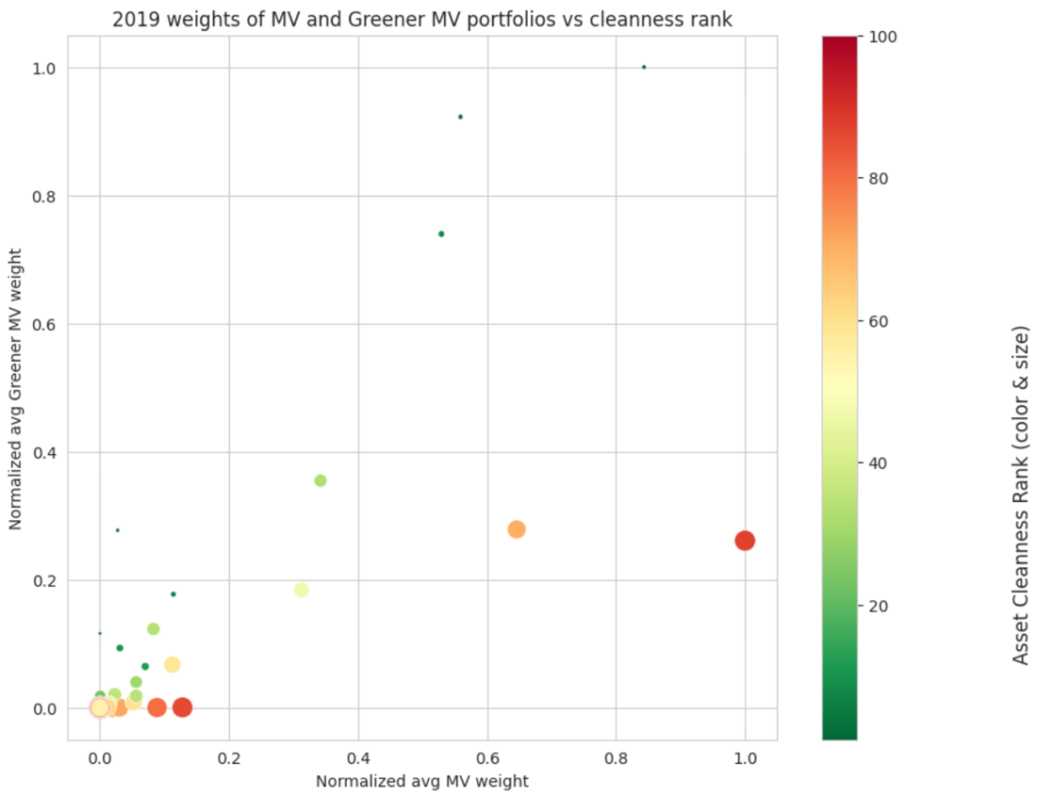
Q5: The Greener MV portfolio correctly punishes assets that rank low in ‘cleanness’ (2019)
2019 weights of MV & Greener MV portfolios vs cleanness rank
We ranked our assets by ‘Cleanness’ (lowest to highest absolute carbon intensity). Correlations with weights:
Greener MV portfolio weights
x
Cleanness rank
-0.33
Asset cleanness rank (size & color)
Normalized avg Greener MV weight
Asset cleanness rank (color & size)
MV portfolio weights
x
Cleanness rank
~0
Normalized avg MV weight

Slide 19
Q5: The Greener MV portfolio modified positions based on emissions, but still valued stable assets
Table: top 10 assets of the Greener MV portfolio by avg weight (2019)
= assets also in top 10 MV
Avg. cleanness rank of top 10 increased positions: 12.9
Avg. cleanness rank of top 10 decreased positions: 67.4
Company name | Avg Greener MV weight (2019) | Cleanness rank
PETRONAS DAGANGAN | 20.89% | 3
UDR | 19.27% | 4
MARICO | 15.45% | 7
OIL & GAS DEVELOPMENT COMPANY | 7.40% | 33
EXXON MOBIL | 5.81% | 70
PAKISTAN STATE OIL COMPANY | 5.78% | 2
QATAR GS.TRAN.NAKILAT | 5.45% | 87
INDIAN OIL | 3.84% | 47
ULTRAPAR PARTICIPOES ON | 3.70% | 5
CABOT OIL & GAS 'A' | 2.56% | 34

Slide 20



Key takeaways
Energy firms have high scope 1 & 3, with significant outliers
Carbon intensity target works better than the exclusion strategy
Carbon intensity strongly depends on the value chain (Exxon vs. Pakistan State Oil)

Slide 21
Portfolio allocation with GHG emissions constraints - Energy Firms
Group 8: Charlotte 🇩🇪, David 🇨🇭🇬🇧, Guillaume 🇨🇭🇵🇹 & Per Christian 🇳🇴
Following: Appendix

Slide 22
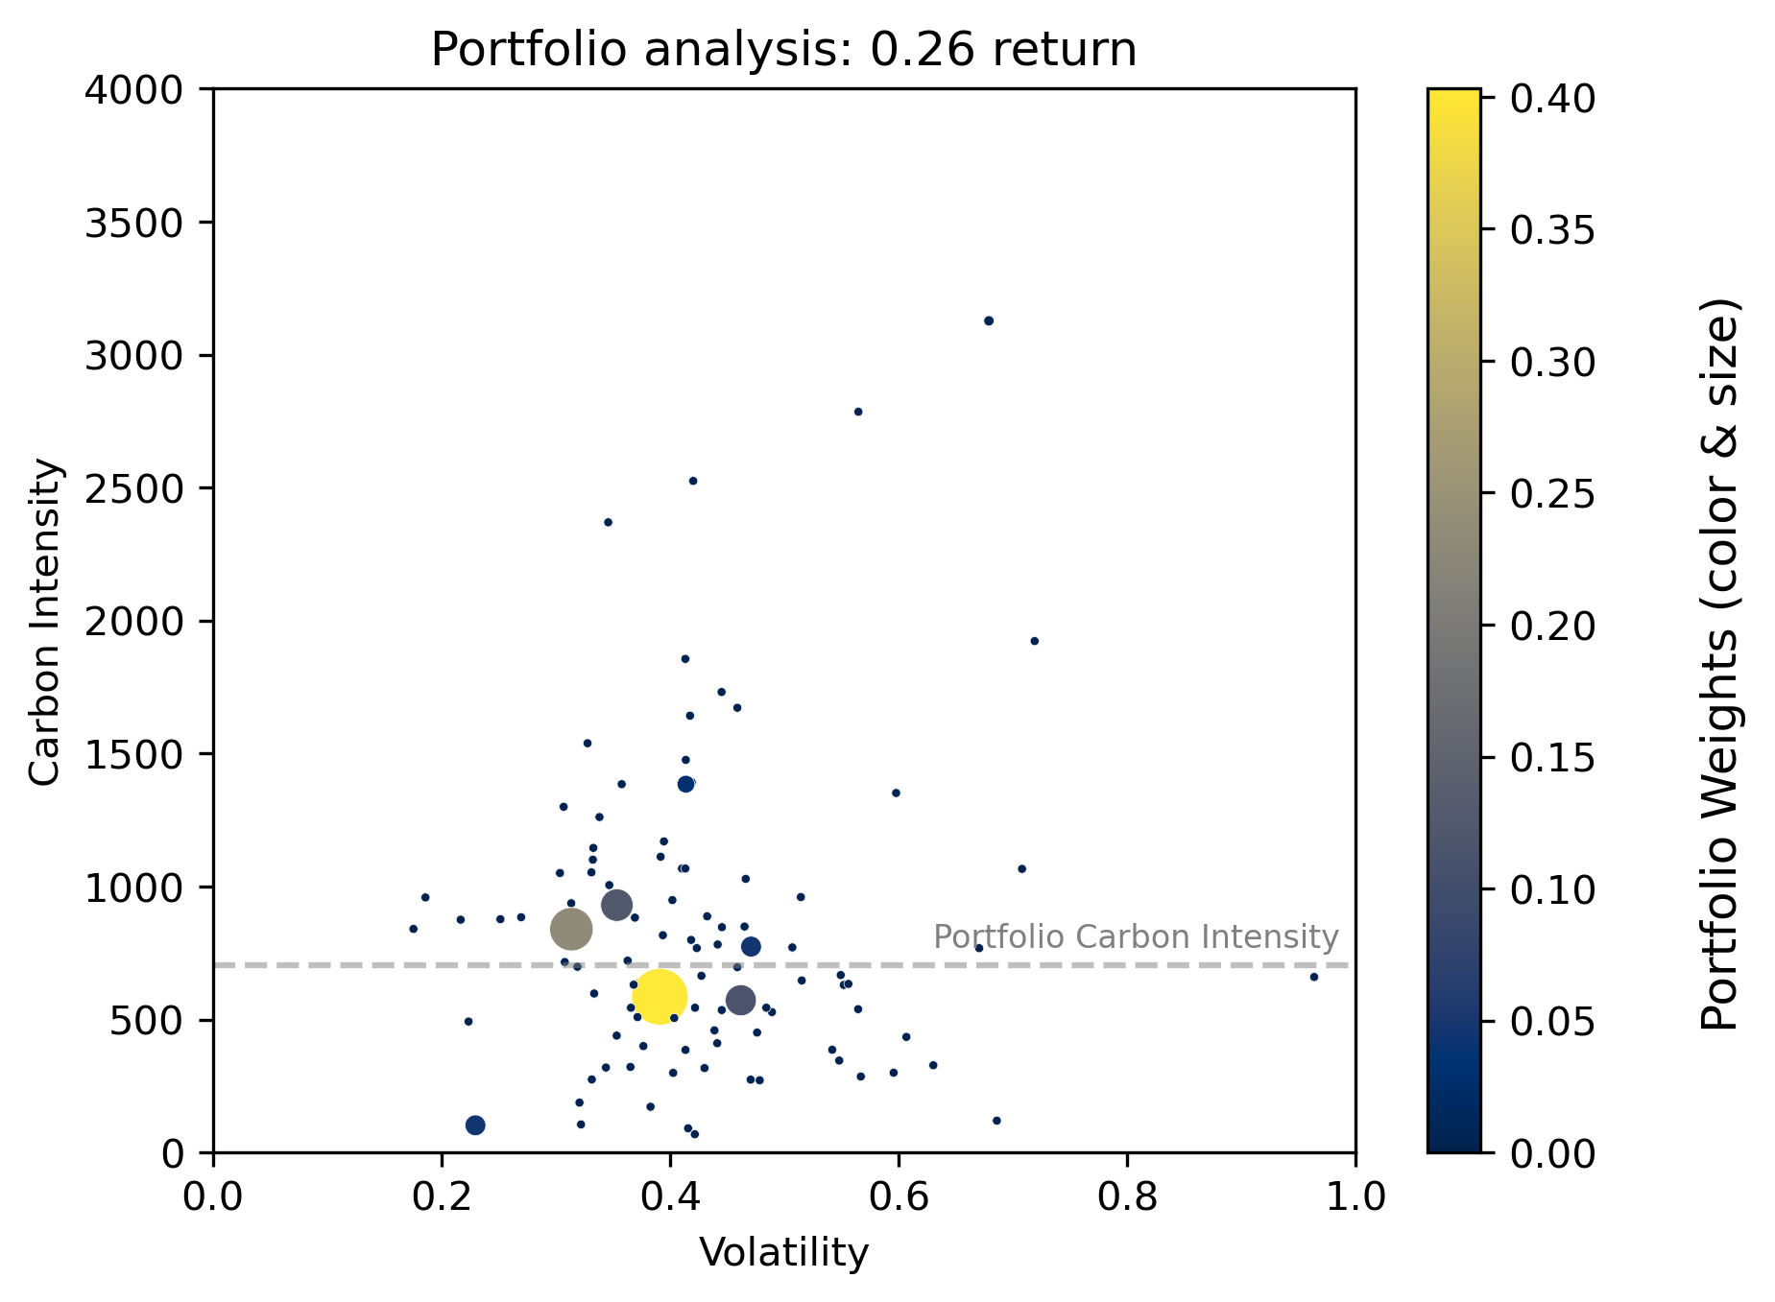
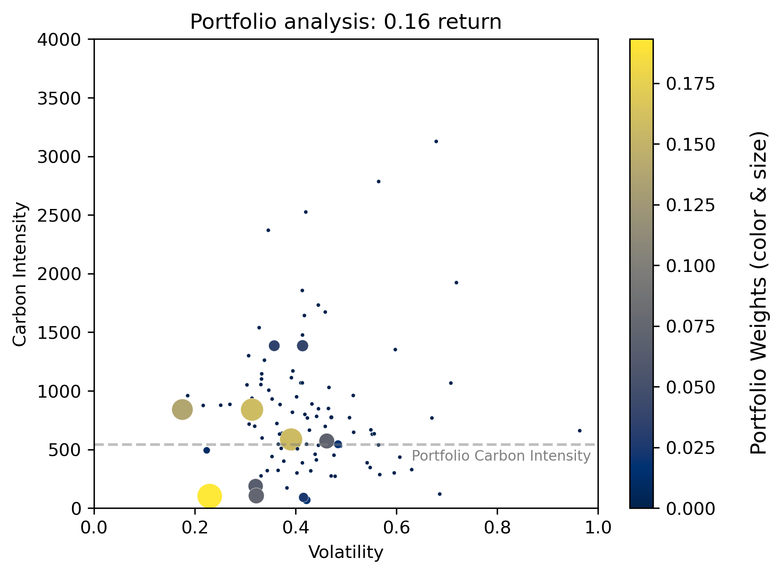
Q2: Different portfolio volatilities lead to very different asset allocations

Slide 23
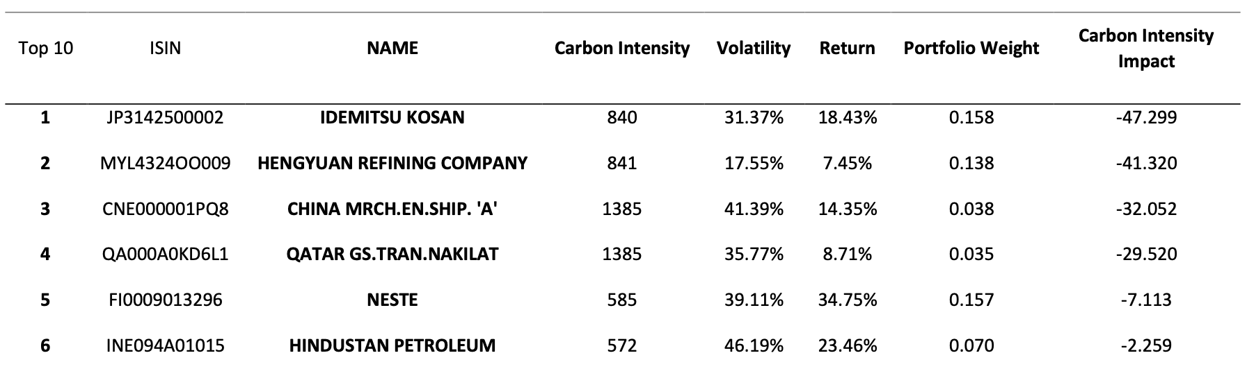
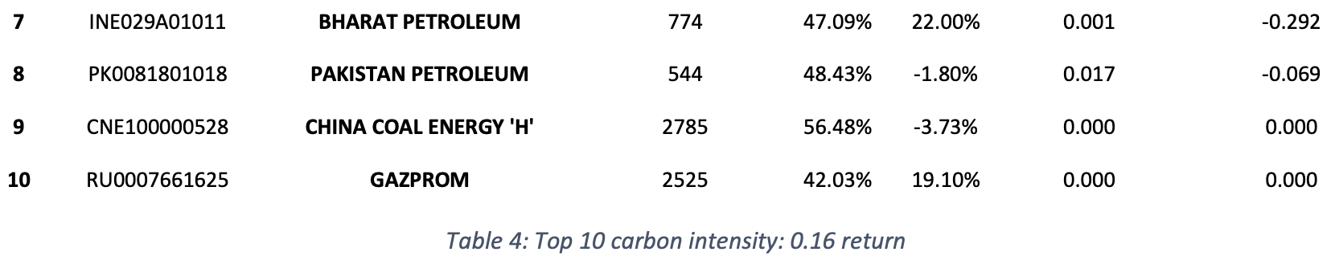
Q2: Portfolio 0.16 return: Top 10 firms driving carbon intensity up

Slide 24
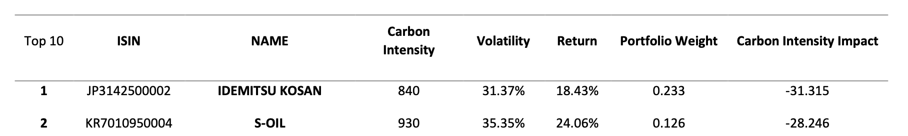
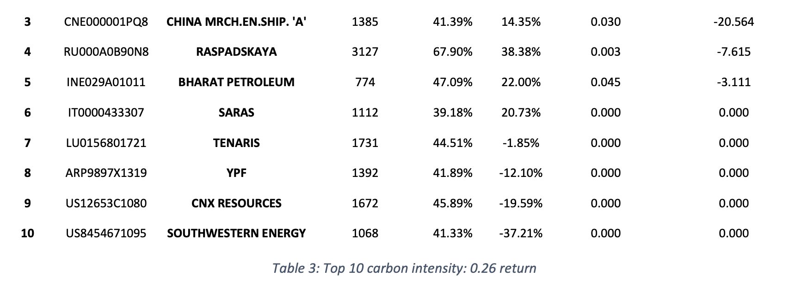
Q2: Portfolio 0.26 return: Top 10 firms driving carbon intensity up

Slide 25
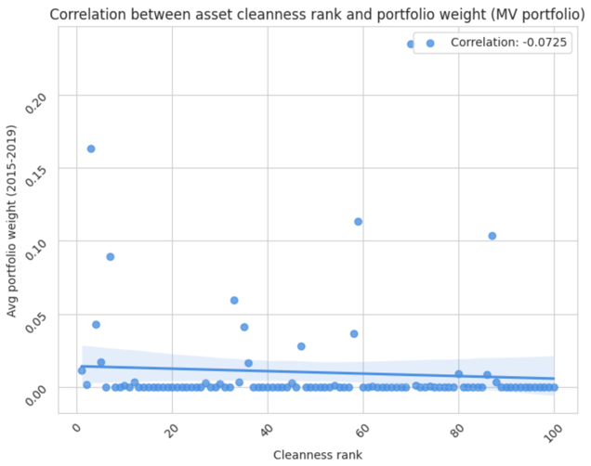
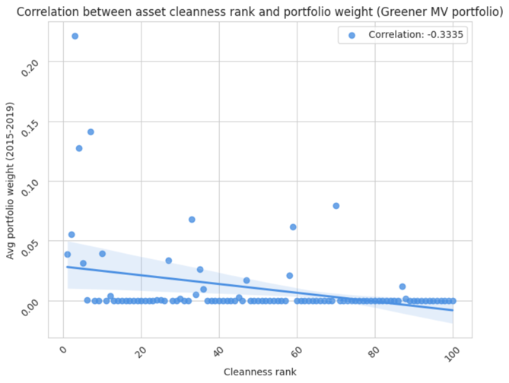
Q5 appendix: The Greener MV portfolio correctly punishes assets that rank low in ‘cleanness’
Here are the correlations between average portfolio weights (2019) and the asset cleanness rank:

Slide 26
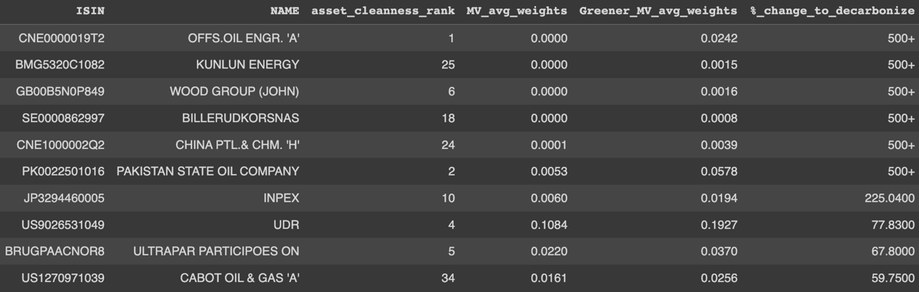
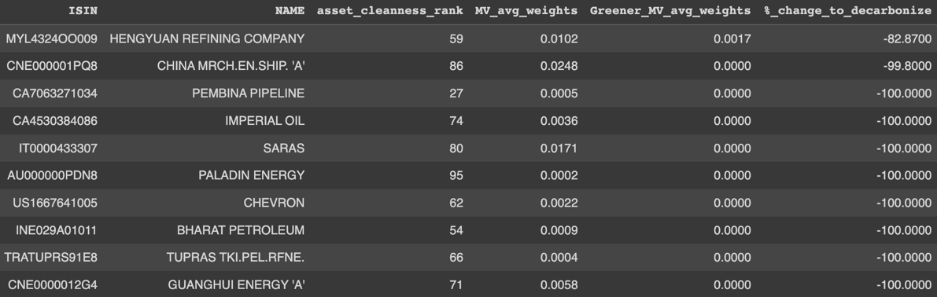
Q5 appendix: top 10 position increases and decreases
Position increases:
Position decreases:

Slide 27
Appendix
Text

